Slide 1
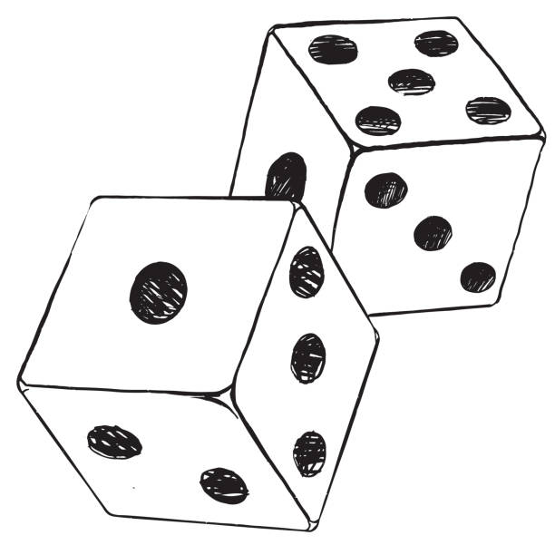
1 – Foundations of Probability Theory
Credit: Getty Images/iStockphoto

Slide 2
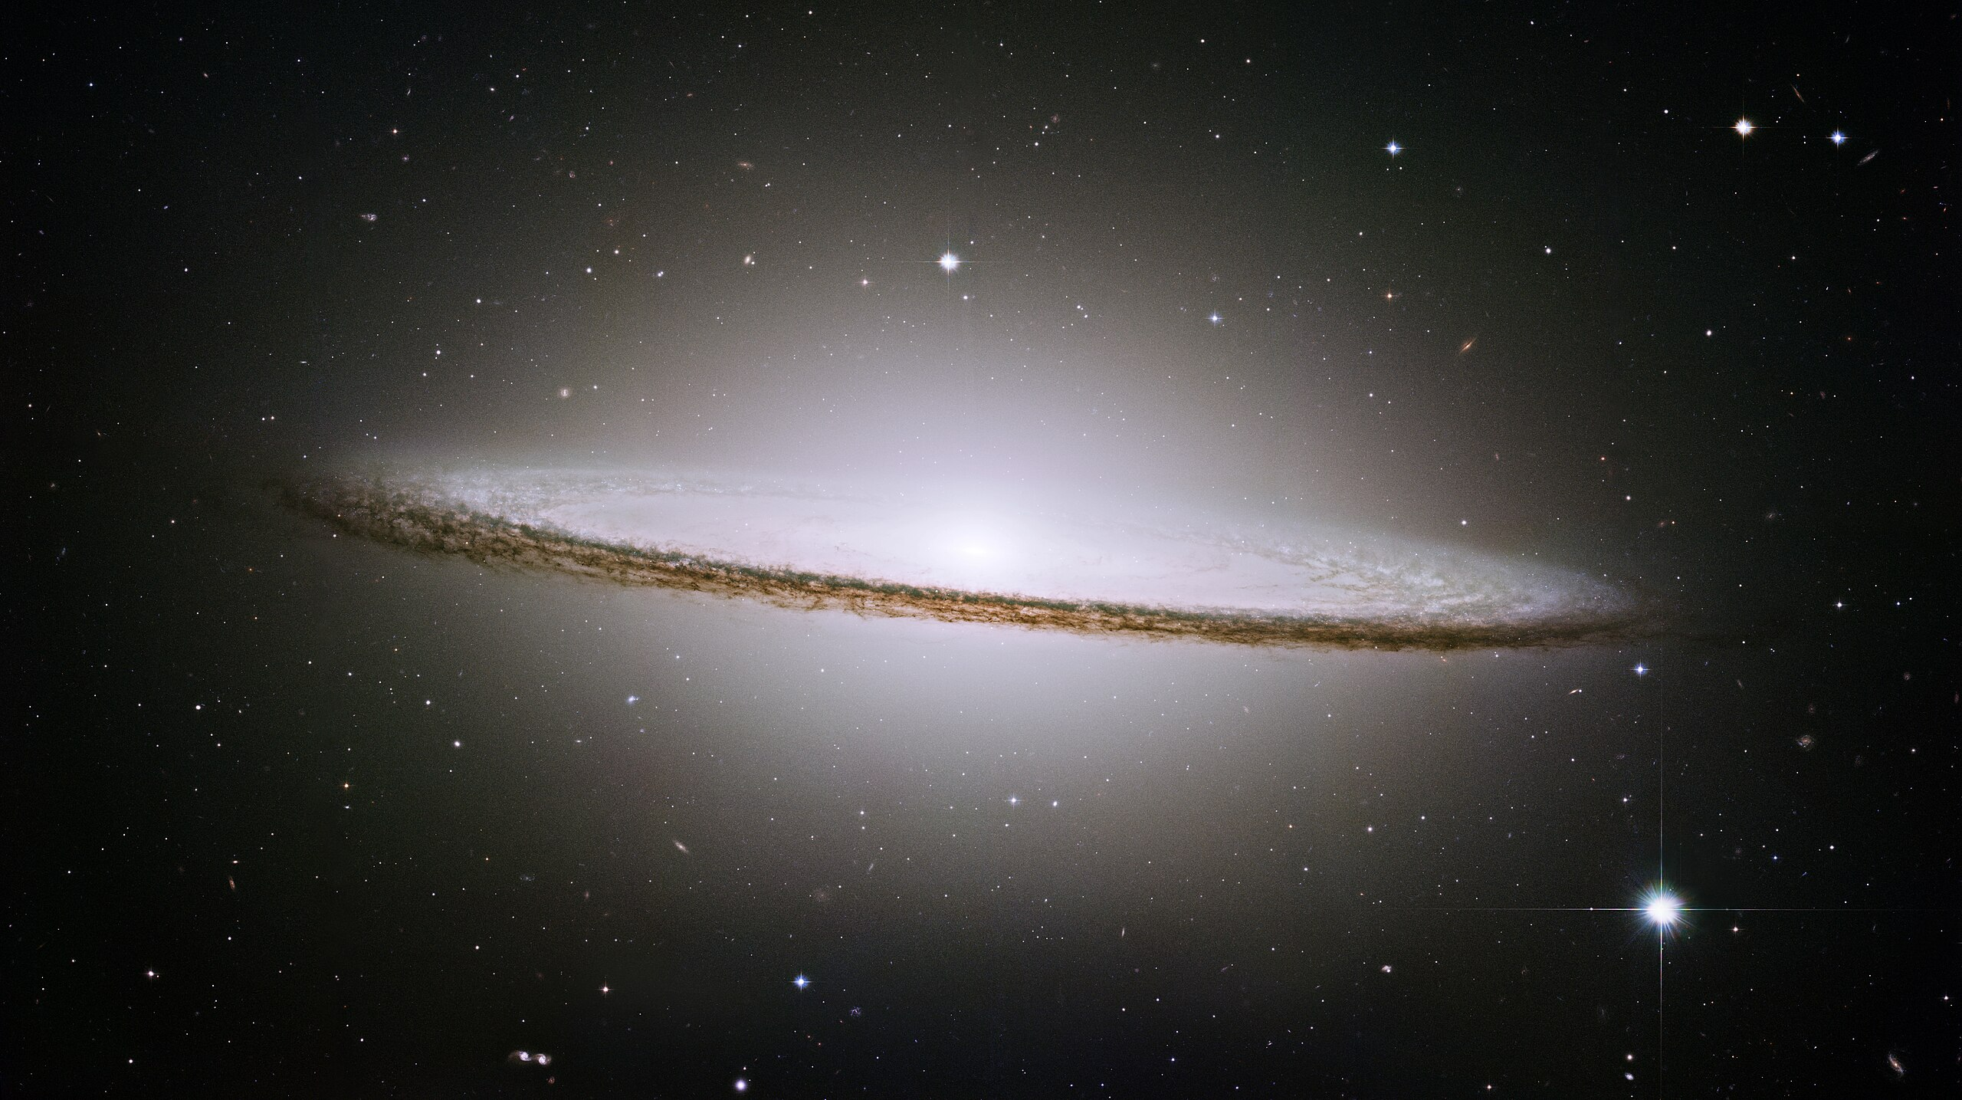
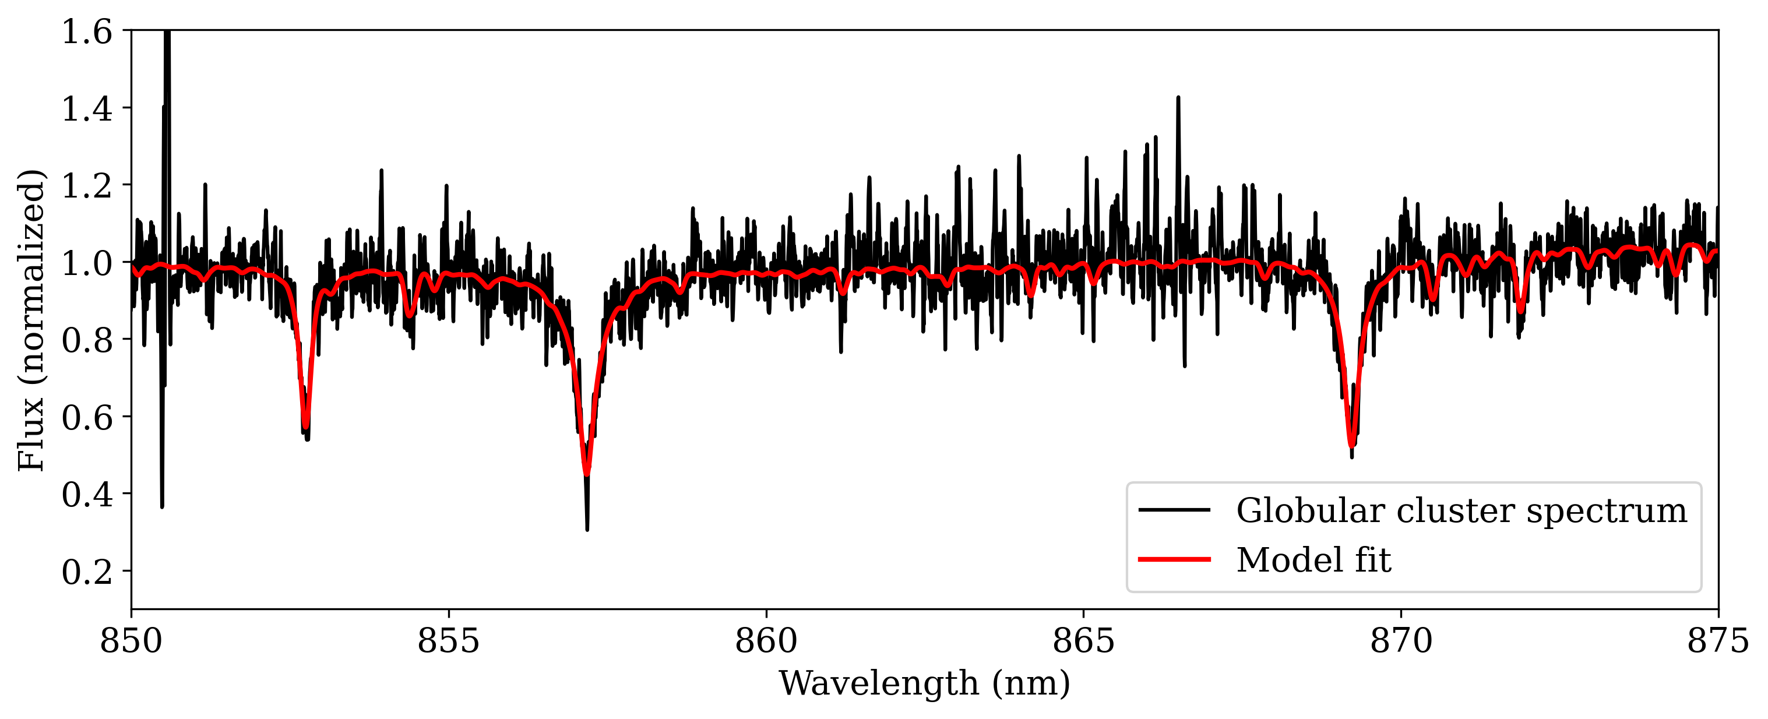
The world, and thus data, is inherently probabilistic
Credit: Katja Fahrion. Wikipedia (Hubble)

Slide 3
Content
Sets
Kolmogorov axioms
Bayes Theorem
Random variables
Chebyshev Inequality
Law of Large Numbers
Transforming random variables
Moment-generating function
Central limit theorem
Chernoff Bounds and Hoeffding’s Inequality
Shannon Entropy

Slide 4
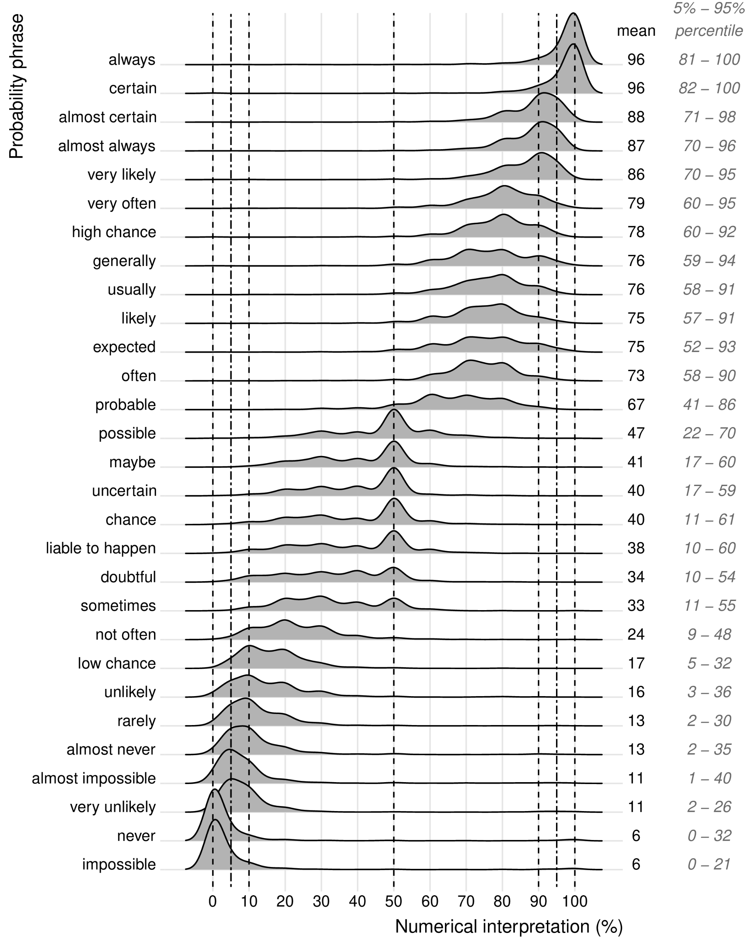
Colloquial interpretation of probability phrases features a wide spread
Developing an intuition about probability is HARD!
Willems, S., Albers, C. and Smeets, I. (2020). Variability in the interpretation of probability phrases used in Dutch news articles — a risk for miscommunication JCOM 19(02), A03.

Slide 5
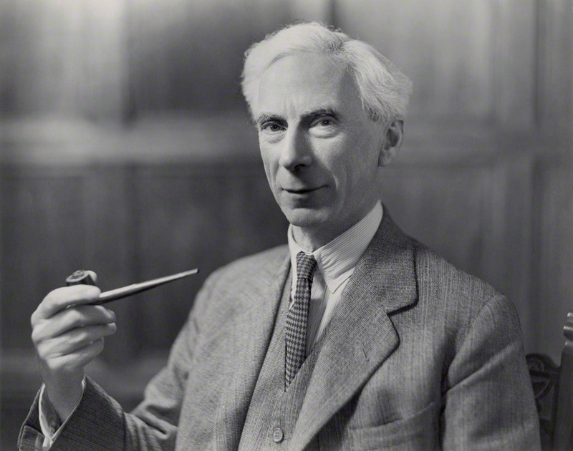





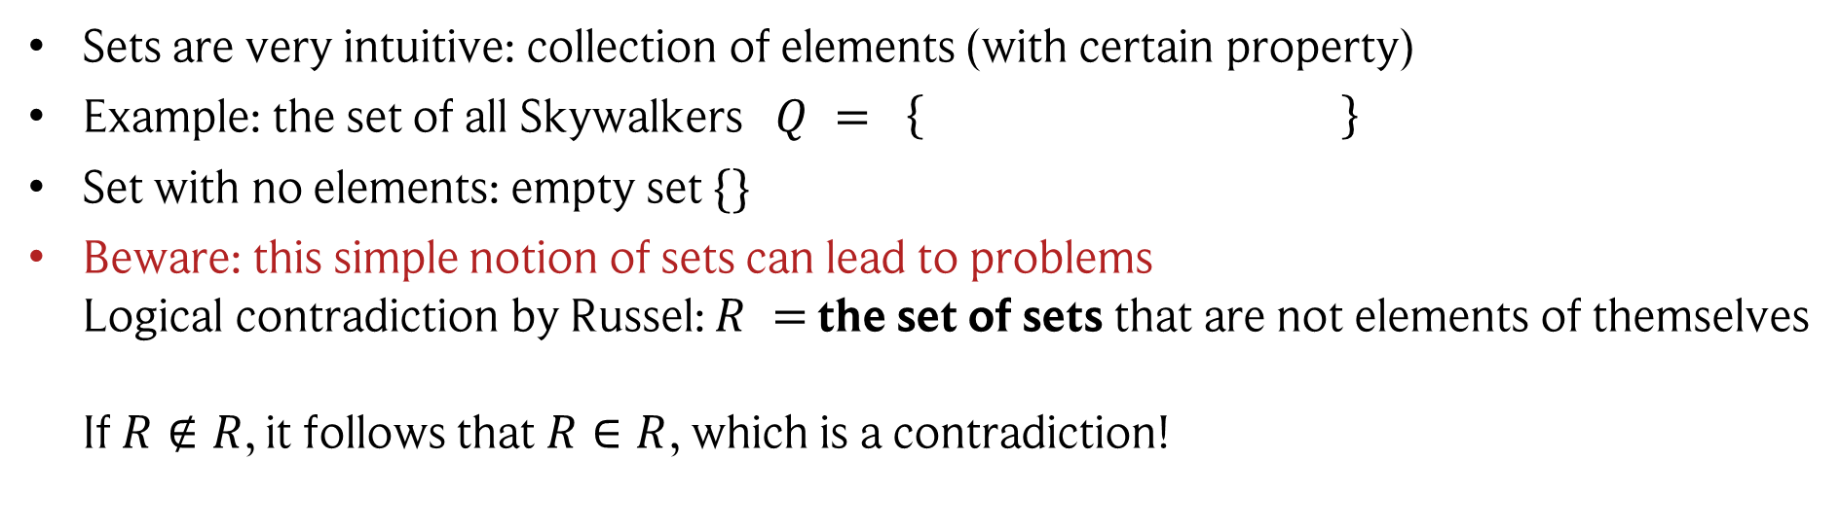

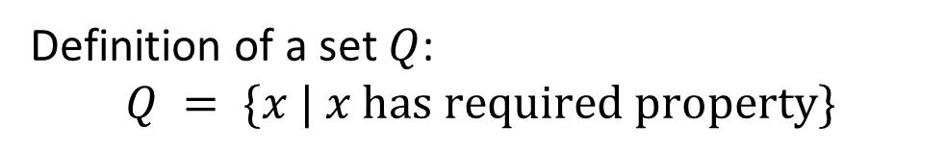
Towards probabilities: set theory
Definition of a set $Q$: $$Q = \{x | x has required property\}$$
Bertrand Russel (1872 - 1970)
Or: $x$ has required property $↔x∈Q$
Sets are very intuitive: collection of elements (with certain property)
Example: the set of all Skywalkers $Q = \left\{ \right\}$
Set with no elements: empty set $\{\}$
Beware: this simple notion of sets can lead to problems Logical contradiction by Russel: $R =$ the set of sets that are not elements of themselves If $R∉R$, it follows that $R∈R$, which is a contradiction!

Slide 6


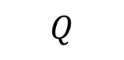
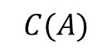
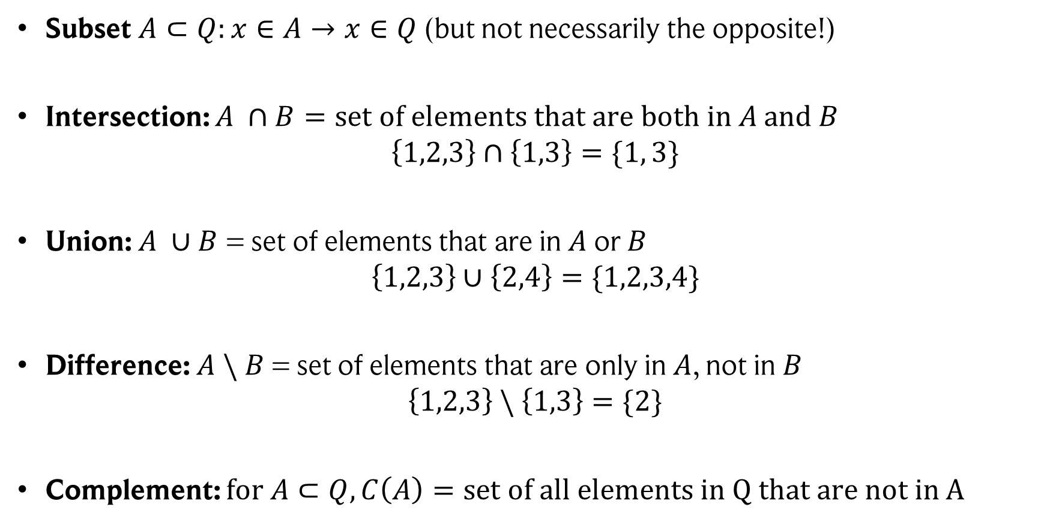

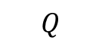



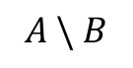
Set operations
Set operations always reduce to logic operations.
$$Q$$
Subset $A⊂Q:x∈A→x∈Q$(but not necessarily the opposite!)
Intersection: $A ∩B=set of elements that are both in A and B$ $\left\{1,2,3\right\}∩\left\{1,3\right\}=\{1, 3\}$
Union: $A ∪B$ = set of elements that are in $A$ or $B$ $\left\{1,2,3\right\}∪\left\{2,4\right\}=\{1,2,3,4\}$
Difference: $A \backslash B$ = set of elements that are only in $A$, not in $B$ $\left\{1,2,3\right\} \backslash \left\{1,3\right\}=\{2\}$
Complement: $for A⊂Q, C\left(A\right)=set of all elements in Q that are not in A$
$$A$$
$$A ∩B$$
$$A$$
$$B$$
$$A ∪B$$
$$A \backslash B$$
$$C(A)$$
$$A$$
$$Q$$

Slide 7
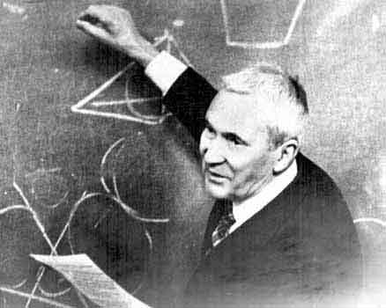
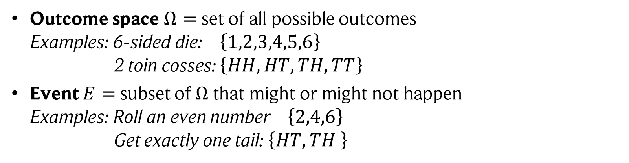

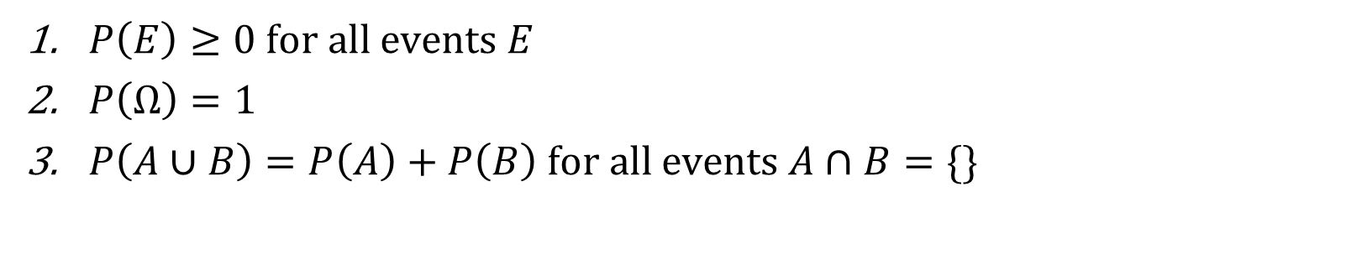
Probability: Kolmogorov axioms
Some simple definitions to set up the stage for our random experiment. A random experiment is defined using sets and set operations:
Outcome space $Ω=$ set of all possible outcomes Examples: 6-sided die: $\left\{1,2,3,4,5,6\right\}$ 2 toin cosses: $\left\{HH, HT, TH, TT\right\}$
Event $E=$ subset of $Ω$ that might or might not happen Examples: Roll an even number $\left\{2,4,6\right\}$ Get exactly one tail: $\left\{HT, TH \right\}$
Andrey Kolmogorov (1903 - 1987)
Then we define a probability measure $P$ such that (Kolmogorov axioms):
$P\left(E\right)≥0 for all events E$
$P\left(Ω\right)=1$
$P\left(A∪B\right)=P\left(A\right)+P\left(B\right) for all events A∩B=\{\}$
$P\left(E\right)$ = probability of event E $(Ω, P)$= probability space

Slide 8
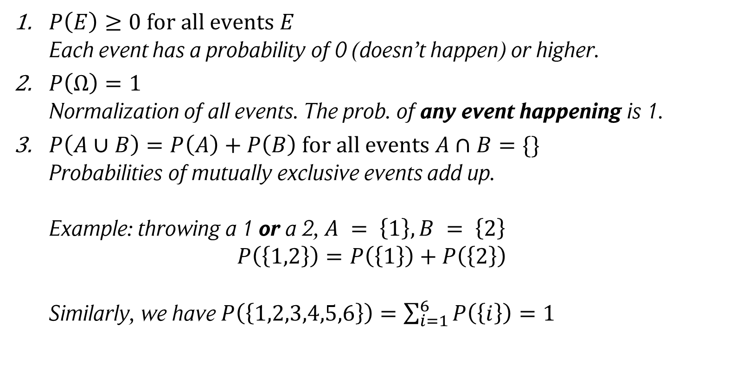
Some intuition behind the axioms
$P\left(E\right)≥0 for all events E$ Each event has a probability of 0 (doesn’t happen) or higher.
$P\left(Ω\right)=1$ Normalization of all events. The prob. of any event happening is 1.
$P\left(A∪B\right)=P\left(A\right)+P\left(B\right) for all events A∩B=\{\}$ Probabilities of mutually exclusive events add up. Example: throwing a 1 or a 2, $A = \left\{1\right\}, B = \left\{2\right\}$ $P\left(\left\{1,2\right\}\right)=P\left(\left\{1\right\}\right)+P\left(\left\{2\right\}\right)$ Similarly, we have $P\left(\left\{1,2,3,4,5,6\right\}\right)=\sum_{i=1}^{6}{P\left(\left\{i\right\}\right)=1}$
Andrey Kolmogorov (1903 - 1987)

Slide 9
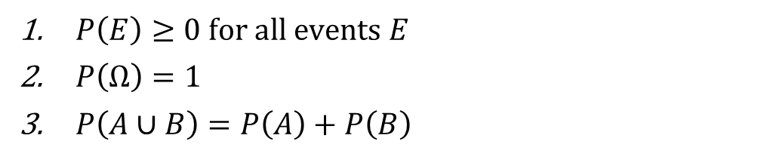
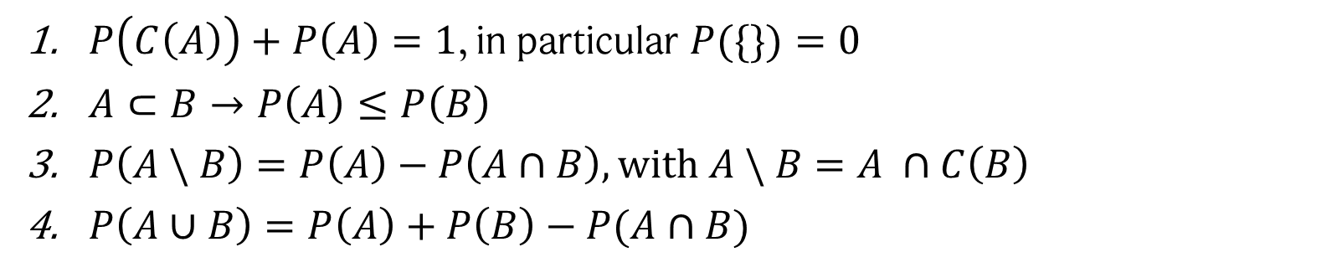
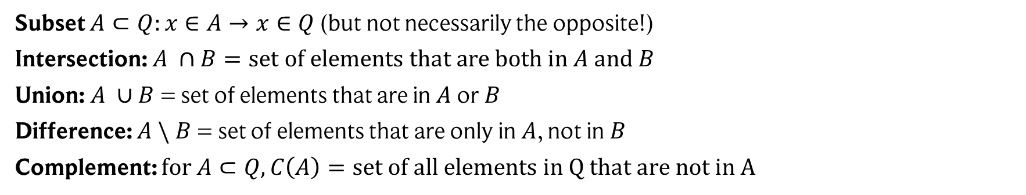
Exercise time
Prove the following relations using the Kolmogorov axioms:
$P\left(C\left(A\right)\right)+P\left(A\right)=1$, in particular $P(\{\})=0$
$A⊂B→P\left(A\right)≤P\left(B\right)$
$P\left(A \backslash B\right)=P\left(A\right)−P\left(A∩B\right), with A \backslash B=A ∩C\left(B\right)$
$P\left(A∪B\right)=P\left(A\right)+P\left(B\right)−P(A∩B)$
Some reminders:
Set operations
Kolmogorov axioms
Subset $A⊂Q:x∈A→x∈Q$(but not necessarily the opposite!)
Intersection: $A ∩B=set of elements that are both in A and B$
Union: $A ∪B$ = set of elements that are in $A$ or $B$
Difference: $A \backslash B$ = set of elements that are only in $A$, not in $B$
Complement: $for A⊂Q, C\left(A\right)=set of all elements in Q that are not in A$
$P\left(E\right)≥0 for all events E$
$P\left(Ω\right)=1$
$P\left(A∪B\right)=P\left(A\right)+P\left(B\right)$
$$for all events A∩B=\{\}$$

Slide 10

Example: rolling a die
$$Outcomes Ω=\{1,2,3,4,5,6\}$$
We assume a rigged die:
$P\left(\left\{1\right\}\right)=P\left(\left\{2\right\}\right)=P\left(\left\{3\right\}\right)=P\left(\left\{4\right\}\right)=P\left(\left\{5\right\}\right)=0.15, P\left(\left\{6\right\}\right)=0.25$
What’s the probability of rolling either an even number or either 3 or 6?
Events: $A=\left\{2,4,6\right\}, B=\left\{3, 6\right\}$
Probabilities: $P\left(A\right)=P\left(\left\{2\right\}\right)+P\left(\left\{4\right\}\right)+P\left(\left\{6\right\}\right)=0.55, P\left(B\right)=0.4$
$$P\left(A∩B\right)=P\left(\left\{6\right\}\right)=0.25$$
Result: $P\left(A ∪B\right)=P\left(A\right)+P\left(B\right)−P\left(A∩B\right)=0.7$

Slide 11
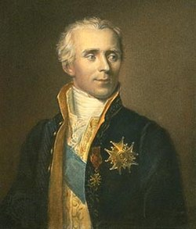
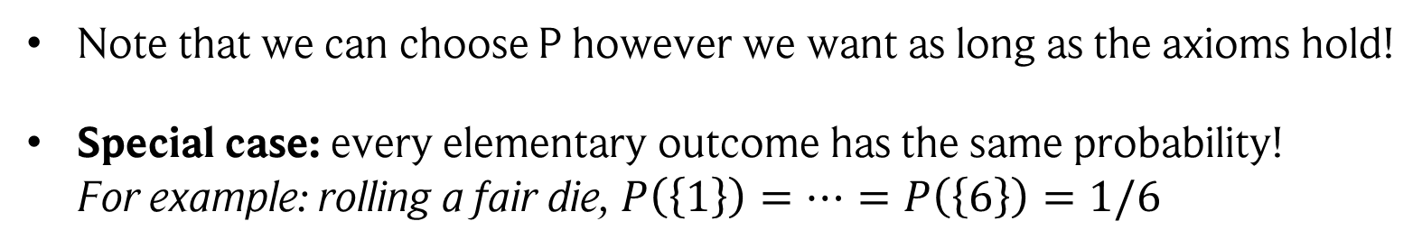
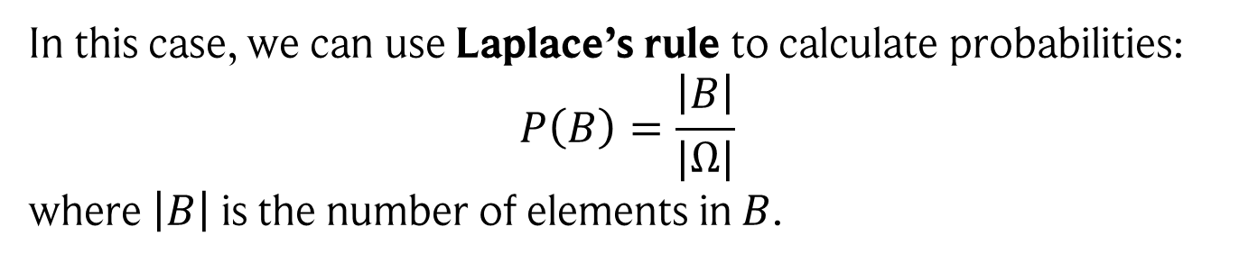
Laplacian probability
Note that we can choose P however we want as long as the axioms hold!
Special case: every elementary outcome has the same probability! For example: rolling a fair die, $P\left(\left\{1\right\}\right)=…=P\left(\left\{6\right\}\right)=1/6$
Pierre-Simon Laplace (1749-1827)
In this case, we can use Laplace’s rule to calculate probabilities: $$P\left(B\right)=\frac{\left|B\right|}{|Ω|}$$ where $\left|B\right|$ is the number of elements in $B$.
Thus, calculating probabilities is equal to counting events!
Example: rolling an even number $P\left(\left\{2,4,6\right\}\right)=\frac{|\left\{2,4,6\right\}|}{|\{1,2,3,4,5,6\}|}=\frac{3}{6}=\frac{1}{2}$
But ONLY applicable if all elementary outcomes have the same probability! E.g., lottery, rolling fair dice, shuffling cards, …

Slide 12

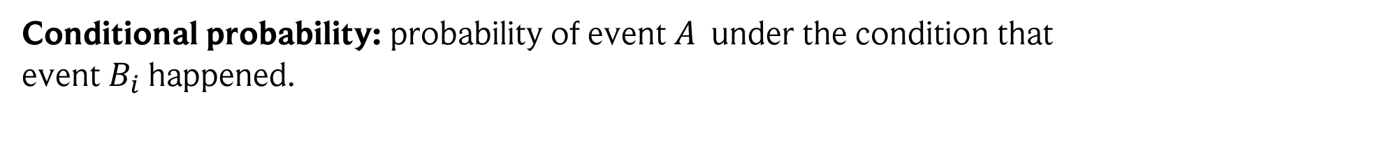

Conditional probabilities
Conditional probability: probability of event $A$ under the condition that event $B_{i}$ happened.
$$P\left(A | B_{i}\right)=\frac{\left|A ∩B_{i}\right|}{|B_{i}|}=\frac{P(A ∩B_{i})}{P(B_{i})}$$
Note that generally $P\left(A | B_{i}\right)≠P(B_{i}|A)$
For example: $P(woman | pregnant) = 1, but P(pregnant \left| woman\right)<1$
We denote by $P\left(A ∩B_{i}\right)=P\left(A,B_{i}\right)$ the probability that both $A$ and $B_{i}$happen.
This is a chain of events: $P\left(A,B_{i}\right)= P\left(A | B_{i}\right)⋅$ $P(B_{i})$
First, $B_{i}$ has to happen
If $B_{i}$ happened, how likely is it that $A$ happened?

Slide 13

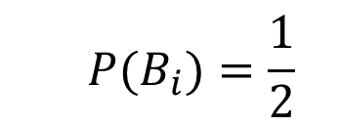

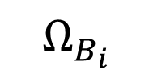




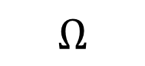
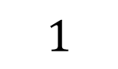

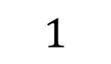
Conditional probabilities: visualization
Our events:
Rolling a power of 2: ${ B}_{i}=\{1,2,4\}$
Rolling an even number: $A=\{2,4,6\}$
If $B_{i}$ happened, how likely is it that $A$ happened?
First, $B_{i}$ has to happen
$$4$$
$$4$$
$$2$$
$$6$$
$$2$$
$$1$$
$$5$$
$$1$$
$$3$$
$$Ω$$
$$Ω_{B_{i}}$$
$${ P(B}_{i})=\frac{1}{2}$$
$$P\left(A | B_{i}\right)=\frac{2}{3}$$
$$P\left(A , B_{i}\right)=\frac{1}{3}$$
See also: https://setosa.io/ev/conditional-probability/
13

Slide 14
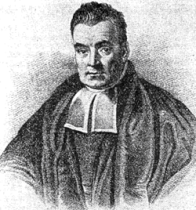




Bayes theorem
Thomas Bayes (1701-1761)
Bayes law: follows directly from the definition of conditional probability.
$$P\left(B_{i} | A\right)=\frac{P\left(A \right| B_{i}) P(B_{i})}{P(A)}$$
Used to swap condition!
NEVER forget this relation!
$$\sum_{i}{P\left(B_{i}\right)=1}$$
$$P\left(A\right)=\sum_{i}{P\left(A \right|B_{i})P\left(B_{i}\right)},$$
Always take into account all possible events!
Basically: account for all events $B_{i}$ that could have led to event $A$.
$$\sum_{i}{P\left(B_{i} | A\right)}=\frac{\sum_{i}{P\left(A \right| B_{i}) P(B_{i})}}{P(A)}=1$$
Also ensures normalization:

Slide 15
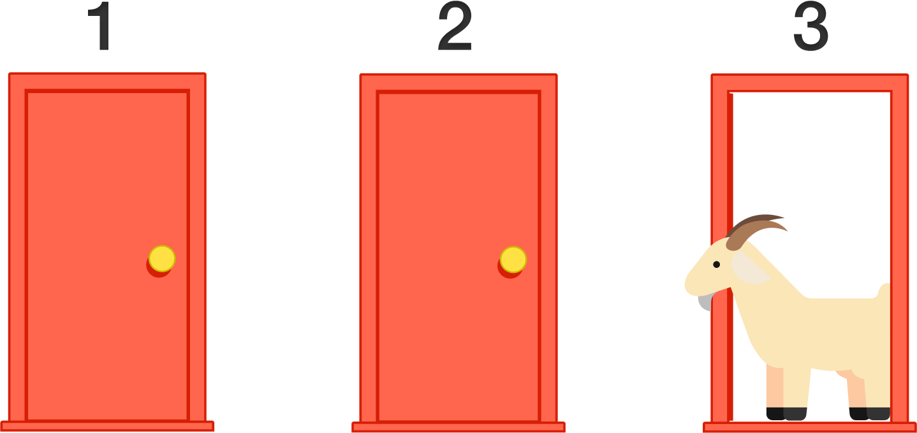

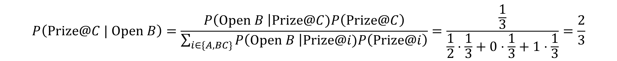


Example: the Monty Hall problem (“Ziegenproblem”)
You are in a gaming show and have to select one of three doors. Two have goats (no win), and one a big prize. After making your decision, the moderator opens one of the remaining doors (but not the one you chose). They give you the chance to swap doors. What are you doing?
Initially, we have to guess…
$P\left(Prize@A\right)=P\left(Prize@B\right)=P\left(Prize@C\right)=\frac{1}{3}$
A
B
C
$Assume we chose A$ and $B$ was opened by the moderator
$$P\left(Open B | Prize@A\right)=1/2$$
$$P\left(Open B | Prize@C\right)=1$$
$$P\left(Open B | Prize@B\right)=0$$
$$P\left(Prize@C | Open B\right)=\frac{P\left(Open B \right|Prize@C)P\left(Prize@C\right)}{\sum_{i∈\{A,BC\}}{P\left(Open B \right|Prize@i)P\left(Prize@i\right)}}=\frac{\frac{1}{3}}{\frac{1}{2}⋅\frac{1}{3}+0⋅\frac{1}{3}+1⋅\frac{1}{3}}=\frac{2}{3}$$
Image credit: https://brilliant.org/wiki/monty-hall-problem/

Slide 16


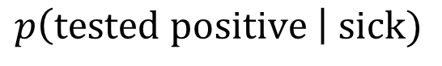
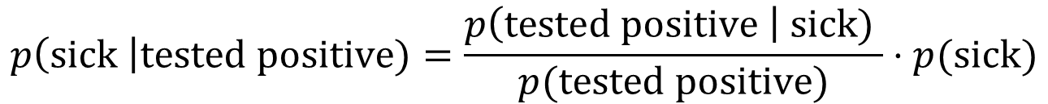
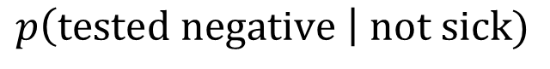
Another example
Sensitivity (true positive rate):
$$p\left(tested positive \right| sick)$$
Specificity (true negative rate):
$$p\left(tested negative \right| not sick)$$
Question: If your test is positive, does this mean your chances of being sick is 97.25%?
$$p\left(sick \right|tested positive)=\frac{p\left(tested positive \right| sick) }{p(tested positive)}⋅p(sick)$$
NO! Apply Bayes theorem:
How common is the disease in your area?
Obtained from manual / lab tests
Note: $p\left(A \right| B)$ does not mean A was caused by B. It only measures correlation (as seen by Bayes theorem: we can switch the order)!

Slide 17

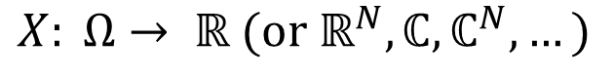

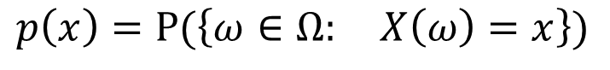
Random variables
A random variable $X$ is a mapping from random events to numbers
$$X: Ω→ ℝ (or ℝ^{N},{ℂ, ℂ}^{N}, …)$$
I.e., a random variable assigns a value to random events!
Examples:
Rolling a die is a random experiment, the number that comes up a random variable.
Drawing a lottery ticket is a random experiment, the money won a random variable.
Measuring the temperature is a random experiment, the obtained value a random variable.
Turning the tables: We can (and usually do) phrase everything in terms of random variables!
$$p\left(x\right)=P(\left\{ω∈Ω: X\left(ω\right)=x\right\})$$
is called the probability distribution of $x$.

Slide 18
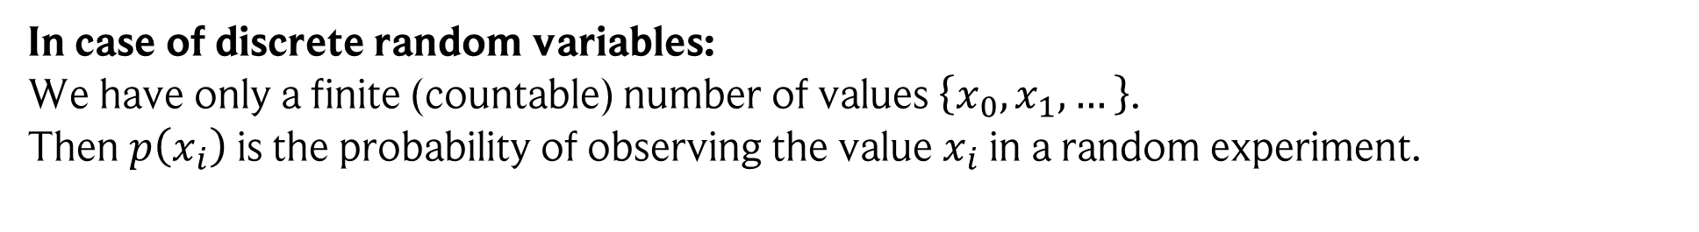
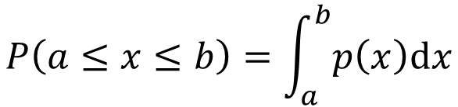
Getting probabilities for random variables
Random variable: values $x$ returned by a random experiment.
Probability distribution: a distribution $p(x)$ over values that $x$ can take. Probabilities are obtained via integration.
In case of discrete random variables: We have only a finite (countable) number of values $\left\{x_{0}, x_{1}, …\right\}$. Then $p\left(x_{i}\right)$ is the probability of observing the value $x_{i}$ in a random experiment.
In case of continuous random variables: E.g., an $ℝ$-valued random variable. In this case, only integral statements make sense.
$$P\left(a≤x≤b\right)=\int_{a}^{b}{p\left(x\right)dx}$$
is the probability for observing a value in the interval $[a,b]$.
I.e., $p\left(x\right)$ is the distribution, and by integrating we get probabilities!

Slide 19
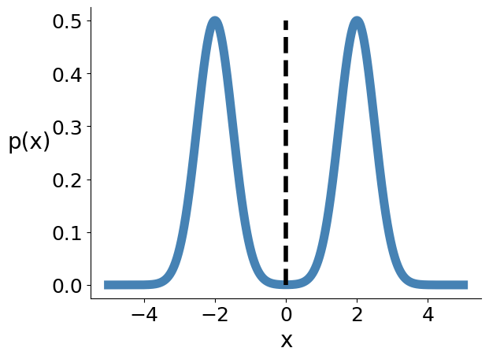
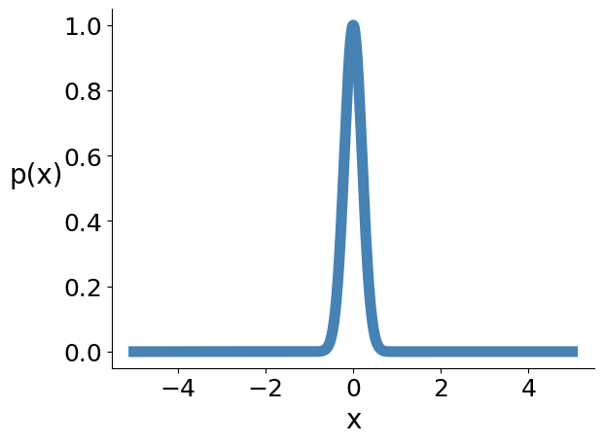
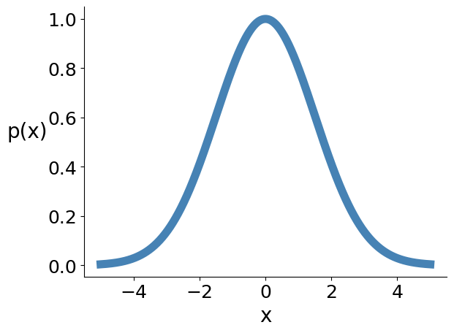
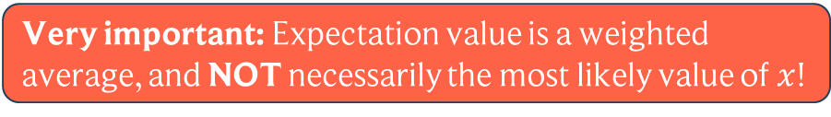
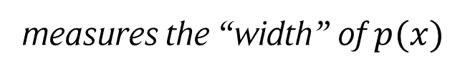
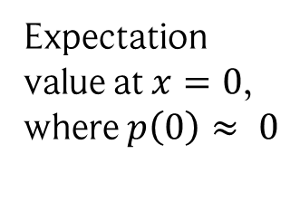
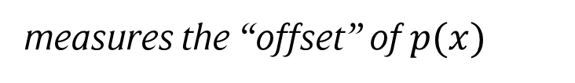
Characterizing probability distributions
Expectation value: $E\left(x\right)=∫x⋅p\left(x\right) dx (E\left(x\right)=\sum_{i}{x_{i}p\left(x_{i}\right)}$ in discrete case)
If we repeat the random experiment many times, which value do we get on average?
measures the “offset” of $p(x)$
Very important: Expectation value is a weighted average, and NOT necessarily the most likely value of $x$!
Variance: $Var\left(x\right)=E\left({\left(X −E\left(X\right)\right)}^{2}\right)$
On average, how far away is the observed value from the expectation value?
measures the “width” of $p(x)$
Note: distribution can be skewed!
Low variance
High variance
Expectation value at $x=0$, where $p\left(0\right)≈ 0$

Slide 20
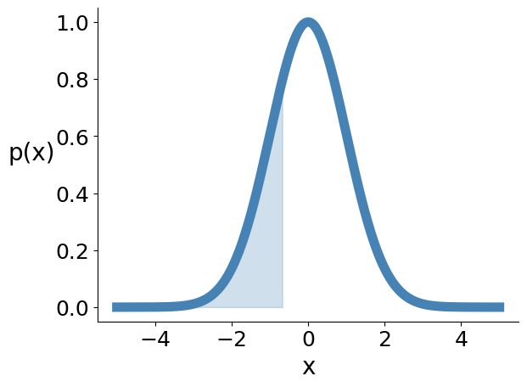

Characterizing probability distributions
Cumulative distribution:$P\left(a\right)=P\left(x≤a\right)=\int_{−∞}^{a}{p\left(x\right)dx}$
Probability of observing a value smaller or equal to a.
$k^{th}$ percentile: $a_{k}$ such that $P\left(a_{k}\right)=k\%$
Good for measuring spread of asymmetric distributions! E.g., using ${25}^{th}$ and ${75}^{th}$ percentile.
Median:${ 50}^{th}$ percentile
25th percentile
Median
Alternative to the expectation value. Less prone to outliers than the expectation value!

Slide 21
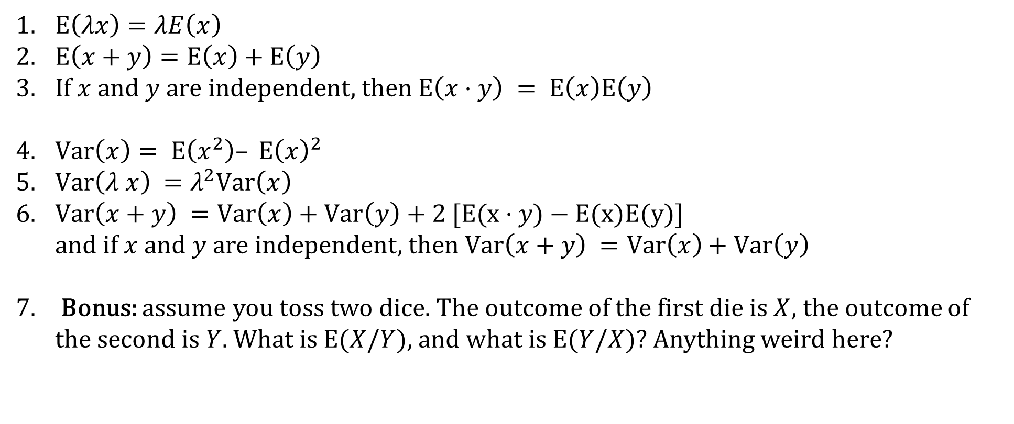
Exercise time
Show that:
$E\left(λx\right)=λE\left(x\right)$
$E\left(x+y\right)=E\left(x\right)+E\left(y\right)$
If $x$ and $y$ are independent, then $E\left(x⋅y\right) = E\left(x\right)E\left(y\right)$
$Var\left(x\right)= E\left(x^{2}\right)– E{\left(x\right)}^{2}$
$Var\left(λ x\right) =λ^{2}Var\left(x\right)$
$Var\left(x+y\right) =Var\left(x\right)+Var\left(y\right)\text{ +}\text{ 2 }[\text{E}\text{(}\text{x}⋅y\text{)}\text{ − }\text{E}\text{(}\text{x}\text{)}\text{E}\text{(}\text{y}\text{)]}$ and if $x$ and $y$ are independent, then $Var\left(x+y\right) =Var\left(x\right)+Var\left(y\right)$
Bonus: assume you toss two dice. The outcome of the first die is $X$, the outcome of the second is $Y$. What is $E(X/Y)$, and what is $E(Y/X)$? Anything weird here?

Slide 22
Time to reflect a bit…
Question: Where do random variables appear in data science?
Environment
Uncertainty in the data
Optimization steps
Hardware/software stack
Model parameters
Uncertainty in data labels

Slide 23
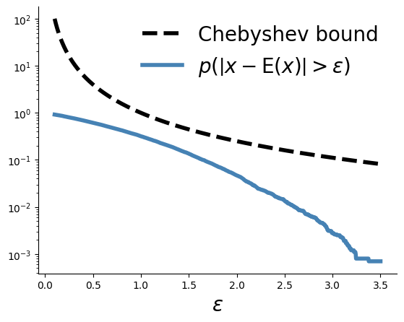
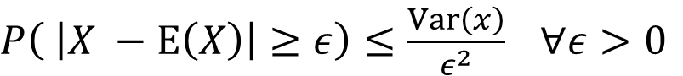
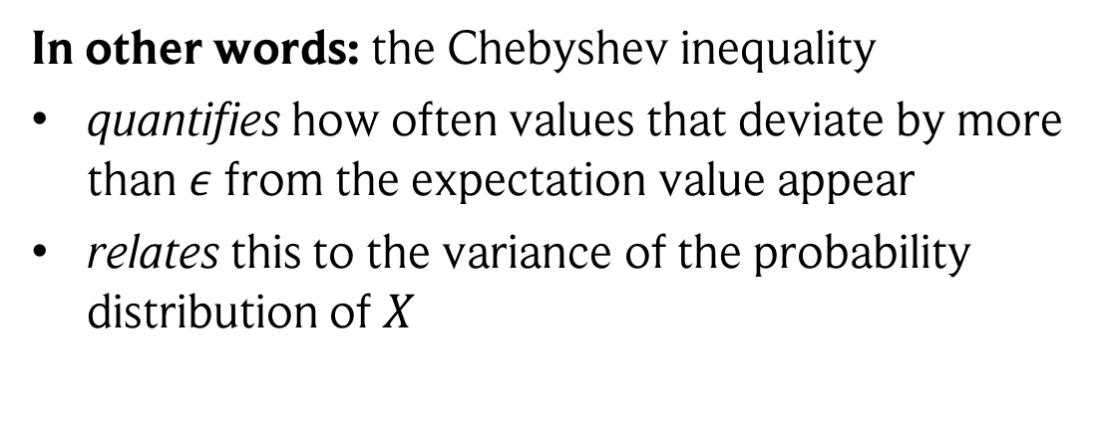
Useful bound: Chebyshev inequality
Chebyshev inequality: Assume a random variable $X$ with finite expectation value $E(X)$and finite variance $Var(X)$. Then the Chebyshev inequality states that
$P\left( \left|X −E\left(X\right)\right|≥ε\right)≤\frac{Var\left(x\right)}{ε^{2}} ∀ε>0$
Proof: see handwritten notes
In other words: the Chebyshev inequality
quantifies how often values that deviate by more than $ε$from the expectation value appear
relates this to the variance of the probability distribution of $X$

Slide 24



A direct consequence: law of large numbers (LLN)
Law of large numbers: Assume random variables $x_{1}, x_{2}, …, x_{n}$with equal expectation value and finite variance $Var\left(x_{i}\right)≤ M <∞$. Then the law of large numbers states:
$P\left( \left|\frac{1}{n}\sum_{i}{x_{i}} −E\left(x_{1}\right)\right|≥ε\right)≤\frac{M}{nε^{2}} ∀ε>0$
Proof: see handwritten notes
In other words: the law of large numbers
Shows that the arithmetic mean $\frac{1}{n}\sum_{i}{x_{i}}$ converges to the expectation value for large n.
Set the probability $δ =\frac{M}{nε^{2}}$. Then the error $ε$ is given by $ε =\sqrt{\frac{M}{nδ}}$, i.e., $ε∝\frac{1}{\sqrt{n}}$

Slide 25








Some useful random distributions
Uniform distribution in [0,1]:
Normal distribution:
Carl. F Gauß (1777 - 1855)
$$p(x) =\frac{1}{\sqrt{2πσ^{2}}}e^{−\frac{{\left(x−μ\right)}^{2}}{2 σ^{2}}}$$
$μ$: mean $σ^{2}$: variance
$p(x) =Θ(x)Θ(1−x)$
with
$1$ if $x≥0$
$$Θ\left(x\right)=$$
$0$ otherwise
Incredibly fundamental, appears super often! So don’t forget this one!

Slide 26



Transforming random variables
Suppose you know the distribution $p(x)$ of a random variable $x$. Question: can you write down the distribution of a function $y=f(x)$?
Yes: we require that probabilities are conserved locally. So, we substitute in the integral!
$∫p\left(x\right)dx=∫p\left(x\left(y\right)\right)\frac{dx}{dy} dy=∫q\left(y\right)dy$ with $\frac{dx}{dy}={\frac{d}{dy} f}^{−1}(y)$
probability density of interval
$f$ rescales interval length
$$q\left(y\right)= p\left(y\left(x\right)\right){\frac{d}{dy} f}^{−1}(y)$$
Thus, we have:

Slide 27



Examples
Assume: $y=f\left(x\right)=x^{2}$
and $\frac{d}{dy}f^{−1}\left(y\right)=\frac{1}{2\sqrt{y}}$
Then: ${ f}^{−1}\left(y\right)=\sqrt{y}$
Thus: $q\left(y\right)=p\left(\sqrt{y}\right)⋅\frac{1}{2\sqrt{y}}$
Example: $p(x)$ is the uniform distribution
There is a way to construct transformations by hand: “inversion sampling” (not covered in this lecture)!

Slide 28

Adding (and subtracting) random variables
Question: assume we add two random variables $x$ and $y$, which both follow two different random distributions $p(x)$ and $p(y)$. What is the random distribution p(z) of $z = x + y$?
A helpful tool for these types of questions: the Dirac-Delta distribution $δ$
$$f\left(c\right) if c∈[a,b]$$
$$\int_{a}^{b}{f(x)δ\left(x−c\right)dx} =$$
$$0 otherwise$$
Idea: for a value $z$, sum up the probabilities of all combinations of values of $x$ and $y$ that sum up to $z$
$$p\left(z\right)=∫dx ∫dy p\left(x\right)p\left(y\right)δ\left(z−x−y\right)=∫dx p\left(x\right)p(z−x)$$
Thus, the sum distribution is the convolution of the two individual distributions!

Slide 29
Multiplying and dividing random variables
Question: assume we multiply two random variables $x$ and $y$, which both follow two different random distributions $p(x)$ and $p(y)$. What is the random distribution p(z) of $z = xy$?
Same idea as for adding random variables!
$$p\left(z\right)=\int_{−∞}^{∞}{dx \int_{−∞}^{∞}{dy p\left(x\right)p\left(y\right)δ\left(z−xy\right)}}=\int_{−∞}^{∞}{\frac{dx}{\left|x\right|}p\left(x\right)p\left(z/x\right)}$$
Question: What is the random distribution p(z) of $z =y/x$?
$$p\left(z\right)=\int_{−∞}^{∞}{dx \int_{−∞}^{∞}{dy p\left(x\right)p\left(y\right)δ\left(z−y/x\right)}}=\int_{−∞}^{∞}{dx \left|x\right| p\left(x\right)p\left(z⋅x\right)}$$

Slide 30





Exercise time
Assume two random variables $x, y$($x,y∈ [0,1]$) with independent uniform distributions. Calculate:
The distribution p(z) of $z=x⋅y$
The distribution p(z) of $z=x/y$
$$δ\left(ax\right)=\frac{1}{\left|a\right|}δ(x)$$
using
Some reminders:
$1$ if $x≥0$
Uniform distribution in [0,1]: $p(x) =Θ(x)Θ(1−x)$ with
$p\left(z\right)=\int_{−∞}^{∞}{\frac{dx}{\left|x\right|}p\left(x\right)p\left(z/x\right)}$ for $z=x⋅y$
$p\left(z\right)=\int_{−∞}^{∞}{dx \left|x\right| p\left(x\right)p\left(z⋅x\right)}$ for $z=x/y$
$$Θ\left(x\right)=$$
$0$ otherwise

Slide 31









Examples
Uniform distributions
Normal distributions
$$p\left(x\right)=\ln\left(\frac{1}{x}\right)Θ(x)$$
$$p\left(x\right)=\frac{K_{0}\left(|x|\right)}{π}$$
$K_{0}:$ K-form Bessel function
$$p\left(x\right)=\frac{1}{π}\frac{1}{1+x^{2}}$$
$$p\left(x\right)=\frac{1}{2}Θ\left(x\right)Θ\left(1−x\right) \\ +\frac{1}{2x^{2}}Θ(x−1)$$
Cauchy distribution
NO finite mean and variance. Chebyshev & law of large numbers do not apply!

Slide 32




Moment-generating function
Given a probability distribution $p(x)$, its corresponding moment-generating function is:
$$φ_{x}\left(t\right)=E\left(e^{tx}\right)=\int_{−∞}^{∞}{{dx e}^{tx}p(x)}$$
Laplace transform of $p(x)$!
Why moment-generating function?
$$e^{tx}=\sum_{i=0}^{∞}{\frac{{(tx)}^{i}}{i!}}$$
The name becomes clear when plugging in the Taylor expansion of
$$φ_{x}\left(t\right)=\int_{−∞}^{∞}{{dx e}^{tx}p(x)}=\sum_{i=0}^{∞}{\frac{1}{i!}\int_{−∞}^{∞}{dx {\left(tx\right)}^{i}p(x)}}=\sum_{i=0}^{∞}{\frac{t^{i}}{i!}E(x^{i}) }$$
$${\frac{d^{n}}{dt^{n}}φ}_{x}\left(t\right){\left.​\right|}_{t=0}=E(x^{n})$$
Moments extractable by differentiation!

Slide 33



Moment-generating function of a Gaussian
$p\left(x\right)=\frac{1}{\sqrt{2π} σ} e^{−\frac{{\left(x−μ\right)}^{2}}{2 σ^{2}}}$
$$φ_{x}\left(t\right)=e^{tμ+\frac{1}{2}t^{2}σ^{2}}$$
Proof: see handwritten notes
Unique property of normal distributions:
$${κ_{n}=\frac{d^{n}}{dt^{n}}lnφ}_{x}\left(t\right){\left.​\right|}_{t=0}$$
Define the cumulants of a probability distribution as
$${lnφ}_{x}\left(t\right)=\sum_{i=1}^{∞}{\frac{κ_{n}(x)}{n!}t^{n}}$$
thus
A probability distribution is Gaussian if only the first two cumulants are non-zero!
$$κ_{1}=μ$$
$$κ_{2}=σ^{2}$$

Slide 34




Application 1: Central limit theorem (never forget!)
Central limit theorem: Assume $n$ independent random variables $x_{i}$ with finite expectation value $E\left(x_{i}\right)≤ A < ∞$ and finite variance $Var\left(x_{i}\right)≤ B <∞$. Let $z=\frac{1}{\sqrt{n}}\sum_{i=1}^{n}{x_{i}}$.
F$or n→∞$, $z$ is Gaussian distributed with mean $μ=\frac{1}{\sqrt{n}}\sum_{i}{E\left(x_{i}\right)},$variance $σ^{2}=\frac{1}{n}\sum_{i}{Var(x_{i})}.$
Proof: see handwritten notes
THIS is the reason the normal distribution is everywhere!
BUT: Only true in the limit and with rescaling ($\frac{1}{\sqrt{n}}$).
In practice: often already works well for small values of $n$.
AND: Only true for random variables with finite variance. For example: The sum of two random variables that follow a Cauchy distribution also follows a Cauchy distribution…

Slide 35












Examples
Summing up uniform distributed random variables (samples shifted and rescaled)
$$n=1$$
$$n=2$$
$$n=4$$
Gaussian
Samples
Sum of random variables following a Cauchy distribution (obviously not Gaussian)
$$n=1$$
$$n=2$$
$$n=2000$$

Slide 36



Application 2: improved bounds
Markov’s inequality: Assume a positive random variable $x$. Then:
$P\left( x≥ε\right)≤\frac{E(x)}{ε} ∀ε>0$
Chernoff Bound: Assume a random variable $x$ with density function $p(x)$. Further assume that $t > 0$. Then
$P\left( x≥ε\right)≤\inf_{t}\left(e^{−tε}φ_{x}\left(t\right)\right) ∀ε>0$
Chernoff Bound for Gaussians: Assume random variables $x_{1}, x_{2}, …, x_{n}$with the same normal distribution. Then
$P\left( \left|\frac{1}{n}\sum_{i}{x_{i}} −E\left(x_{1}\right)\right|≥ε\right)≤2 e^{−\frac{nε^{2}}{2 σ^{2}} } ∀ε>0$
Proofs: see handwritten notes

Slide 37

Comparison with LLN

Slide 38


A fundamental theorem: Hoeffding’s inequality
There are two more observations needed to get to a very general and powerful result:
The Chernoff Bound that we derived for Gaussians is also valid for any random variable with finite support, i.e., $x∈\left[a,b\right]$ is constrained to an interval.
Popoviciu’s inequality on variances: Let $x$ be a random variable with finite support $x$. Then $Var\left(x\right)≤\frac{{\left(b−a\right)}^{2}}{4}$.
Hoeffding’s inequality: Assume independent random variables $x_{1}, x_{2}, …, x_{n}$from the same distribution and finite support $x∈\left[a,b\right]$. Then:
$P\left( \left|\frac{1}{n}\sum_{i}{x_{i}} −E\left(x_{1}\right)\right|≥ε\right)≤2 e^{−\frac{2nε^{2}}{{\left(b−a\right)}^{2}} } ∀ε>0$

Slide 39



Example of applying Hoeffding’s inequality
How many samples (e.g., training data samples!) from the random distribution $p(x)$ do we need such that with probability at least $1−δ$ the average does not deviate by more than $ε$from the expectation value?
Answer: Using Hoeffding’s inequality, we set $δ=2 e^{−\frac{2nε^{2}}{ {(b−a)}^{2}} }$ from which we get:
$$ε=\sqrt{\frac{\left(\ln\left(2\right)−\ln\left(δ\right)\right){\left(b−a\right)}^{2}}{2n}}$$
$$n≥\frac{\left(\ln\left(2\right)−\ln\left(δ\right)\right){\left(b−a\right)}^{2}}{2ε^{2}}$$
and

Slide 40





Information: measuring surprise of random variables
Assume we send a message. The message consists of $n$ independent random variables $x_{1}, x_{2}, …, x_{n}$that can take values [‘A’, ‘B’, ‘C’] with probabilities $p(A), p(B), p(C).$We concatenate the results to get a message.
Example message: A B A C
Likelihood of message: $p(A)p(B)p(A)p(C)$
Question: How much information does the message contain? Or in other words: how many bits are required to encode/store the message?
First: intuitively, a message contains information if it allows us to act.
We require the following properties of an information measure $I$:
$I$ continuously decreases with $p(‘X’)$(less probable events are more surprising)
$I(p\left(‘X’\right)=1) = 0$(always the same signal is not surprising, i.e., has no information)
$I\left(p\left(′X^{′}\right)⋅p\left(′Y^{′}\right)\right) = I(p\left(‘X’\right))+I\left(p\left(‘Y’\right)\right)$(information is additive for indep. RVs)
Solved by $I\left(p\right)= −\log_{2}{(p)}$
log with basis 2 = bits!
Image credit: shutterstock

Slide 41


Shannon entropy and data compression
Claude Shannon (1916 - 2001)
Shannon entropy $H(p)$: the expected information content of a random variable with probability distribution $p$.
$$H\left(p\right)=−\sum_{i}{p_{i}}\log_{2}{p_{i}}$$
$$(H\left(p\right)=−∫p\left(x\right)\log_{2}{p\left(x\right)) }$$
The Shannon entropy provides a lower limit of how messages composed of independent random variables can be compressed!
Shannon’s source coding theorem: $n$ independent random variables with distribution $p$ cannot be compressed into less than $n H(p)$bits without information loss.
Yes! 1) Utilize structure in data; 2) Compress with loss.
Can we compress more in practice?

Slide 42







Kullback-Leibler divergence and thermodynamics
Rolf Landauer (1927 – 1999)
The Kullback-Leibler divergence $D_{KL}$measures how close we are to that optimum!
$$D_{KL}\left(p||q\right)=−\sum_{i}{p_{i}\log_{2}{q_{i}}}−H\left(p\right)=\sum_{i}{p_{i}\log_{2}{\frac{p_{i}}{q_{i}}}}$$
“Assume” probabilities $q_{i}$, but average is done with actual frequencies!
BUT it is not a metric! $D_{KL}(p|\left|q\right)≠D_{KL}(q|\left|p\right)$
$D_{KL}$can be used to measure the similarity of probability distributions.
Curious observation: thermodynamics defines the entropy of physical systems similarly!
Landauer’s principle provides a link: the minimum heat $W$ released when deleting one bit of information in a device operating at temperature $T$ is
$$S\left(p\right)=−k_{B}\sum_{i}{p_{i}}\ln{p_{i}}$$
$$\text{W} ={T ΔS=k}_{B}T\ln{2}$$

